Slide 1
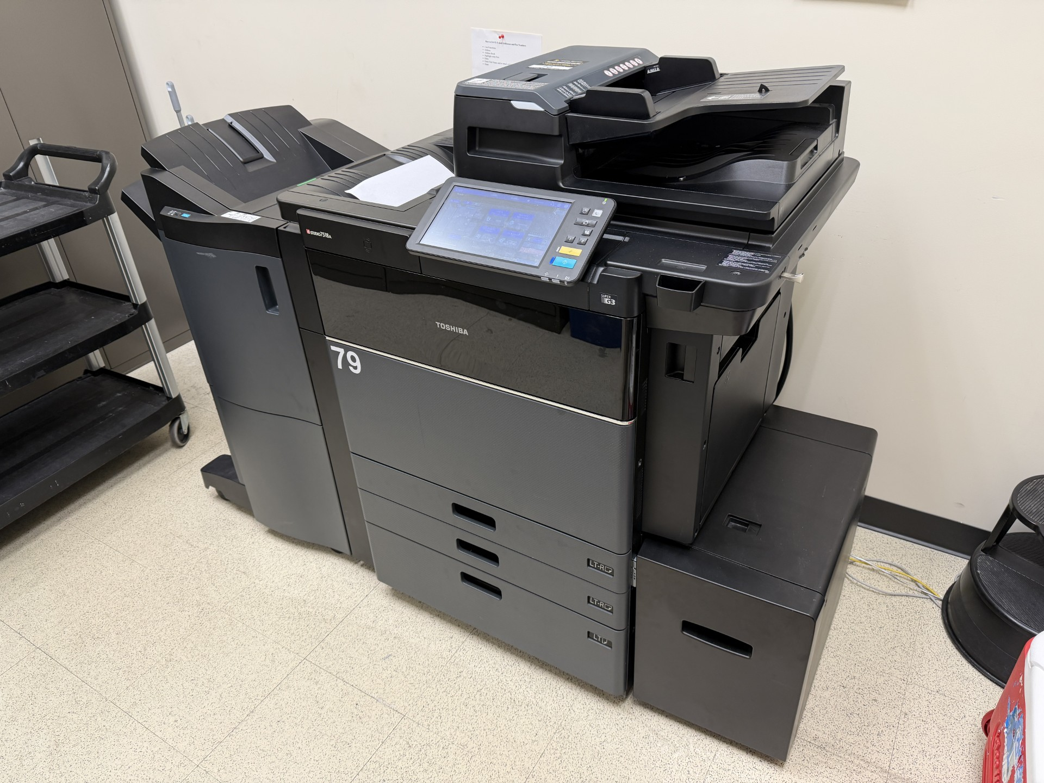
COPY
The ULTIMATE Contact Manager
Team #1
Processes for Object Oriented Software Development (COP 4331C) – Spring 2026 – Section 3 with Dr. Aashish Yadavally

Slide 2

What is COPY?

Slide 3
About The Team

Slide 4
Who Are We?

Slide 5
How Did We Make COPY?

Slide 6
Communications Methods

Slide 7
Version Control

Slide 8
Communications Methods

Slide 9
Gantt Chart

Slide 10
AI Usage

Slide 11
How Did The Construction Go?

Slide 12
Things That Did Go Well

Slide 13
Things That Did NOT Go Well

Slide 14
ERD Chart

Slide 15
How Did We Do In Terms of Accessibility?

Slide 16
Demonstrations

Slide 17
Add Contact Endpoint
Request Method: POST
URL Path: api/user/contacts.php
Purpose: add a new contact to the authenticated user's contact list
Request/Response Content-Type: application/json
Authentication: session cookies
Example Requests
Valid Body:
{
"first_name": "First",
"last_name": "Last",
"email": "first.last@gmail.com",
"phone": "012-345-6789"
}
Invalid Body:
{
"first_name": "First",
"last_name": "Last",
"email": "NOT A GMAIL!!!",
"phone": "abc"
}
Example Responses
Success:
{
"success": true,
"message": "Successfully added contact"
}
Error:
{
"success": false,
"error": "%error-message%"
}
HTTP Response Codes:
200 – OK
400 – Invalid Input
401 – Invalid Session
500 – Internal Server Error
Editor's Note: anyone editing the slides can do whatever to this slide, even remove it if it doesn't fit with the design plan they have for most of the slides
Editor's Note 2: I just realized that powerpoint rubric doesn't mention anything about specifically going over the API's endpoints so this might not be necessary

Slide 18
API Demonstration

Slide 19
Website Demonstration
ADD GIF HERE

Slide 20
Assumptions and Limitations

Slide 21
Any Questions?

Slide 22
Images Used in This Presentation

Slide 23
Thank You!

